Slide 1

IoT SAFE
Researcher: Mohammad Hossein Shafiee

Slide 2
Introduction
IoT SAFE (IoT SIM Applet for Secure End-to-End Communication) offers a standardized, SIM-based solution to secure IoT devices. This lecture covers IoT SAFE's architecture, key components like the Secure Element (SE), APDUs, and its application in scenarios such as device authentication and secure communication. It also discusses key lifecycle management and compares IoT SAFE to traditional, less integrated security approaches, highlighting its advantages in scalability, simplicity, and robustness.

Slide 3
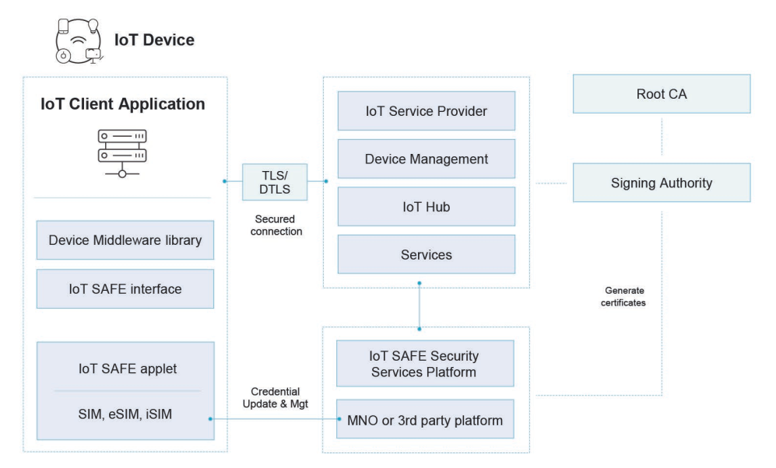
Overview of The Solution

Slide 4
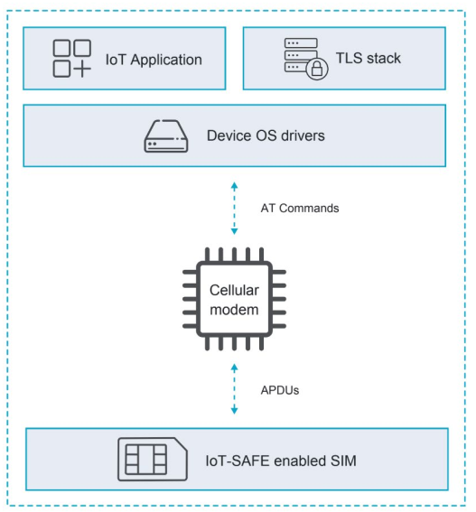
How to access the IoT SAFE applet from the device?

Slide 5
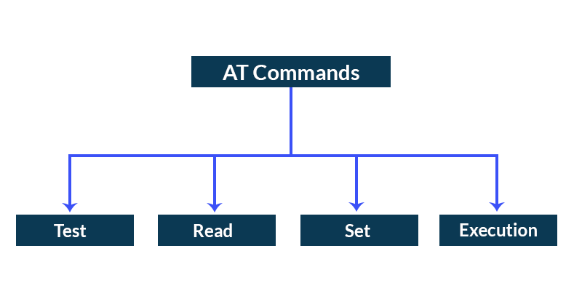
AT Commands
AT commands (short for Attention commands) are a set of instructions used to control and communicate with devices like modems, cellular modules, and other communication devices. They were originally developed for modem control but are now widely used for controlling various types of communication modules, including cellular, GSM, GPS, Wi-Fi, and Bluetooth modules.
AT commands (described in [3GPP_AT]) provides a mean to forward messages to the SIM.

Slide 6
APDU
APDU (Application Protocol Data Unit) is a communication protocol used to interact with smart cards, SIM cards, and other secure elements (such as security tokens). APDU is a set of commands and responses that allow for communication between a smart card reader (or any other terminal) and a smart card or secure chip. These commands are typically used for tasks such as authentication, encryption, storing data, and other security-related operations. It uses ISO/IEC 7816 standard to communicate with SIM.

Slide 7
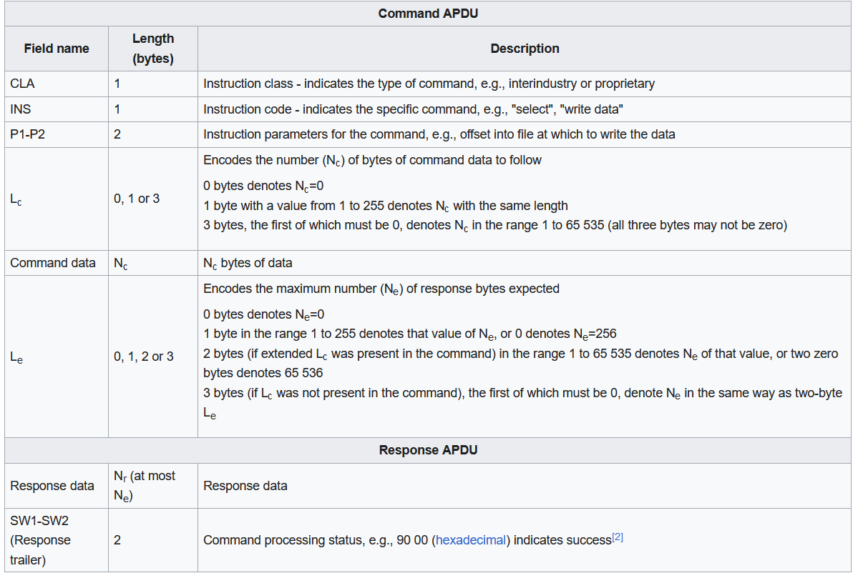
APDU Command Structure

Slide 8
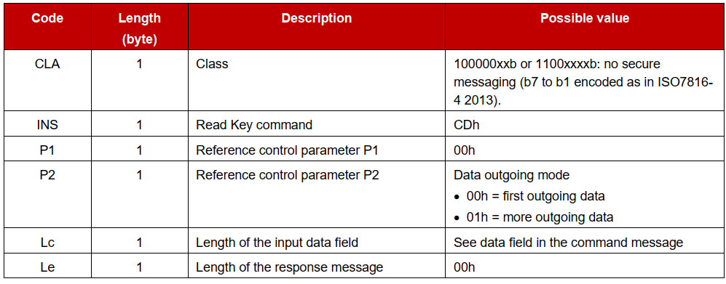
Example of Reading Public Key

Slide 9
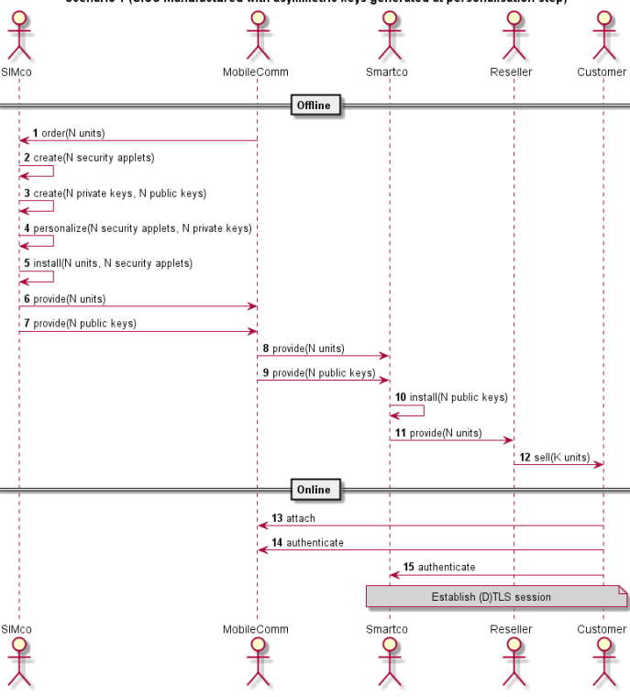
Scenario 1 (UICC manufactured with asymmetric keys generated at personalisation step)

Slide 10
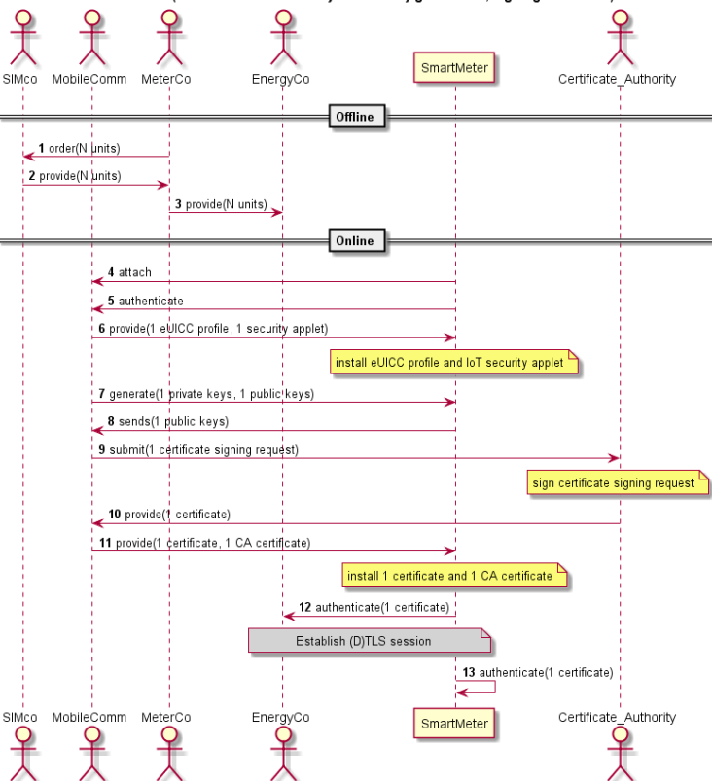
Scenario 2 (eUICC with on-board asymmetric key generation, signing certificate)

Slide 11
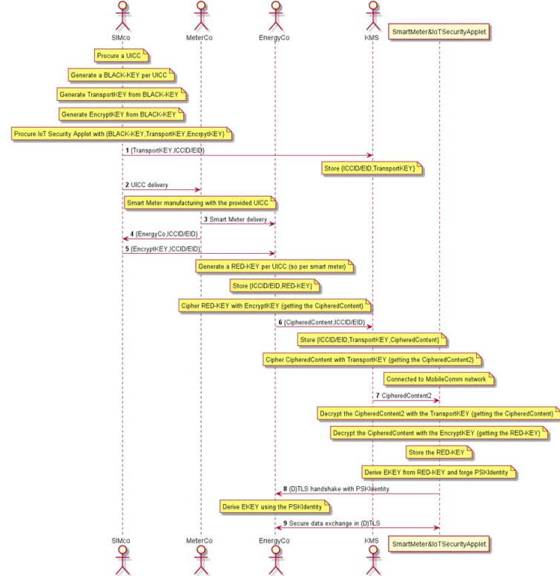
Scenario 3 (PSK#1: UICC manufactured and pre-loaded with set of keyloading keys for application owner to manage their own keys

Slide 12
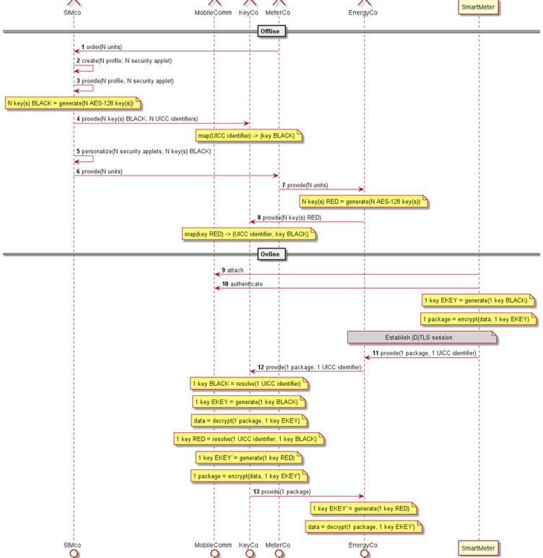
Scenario 4 (PSK#2: Trusted third party manages transport and application security on behalf of application owner)

Slide 13
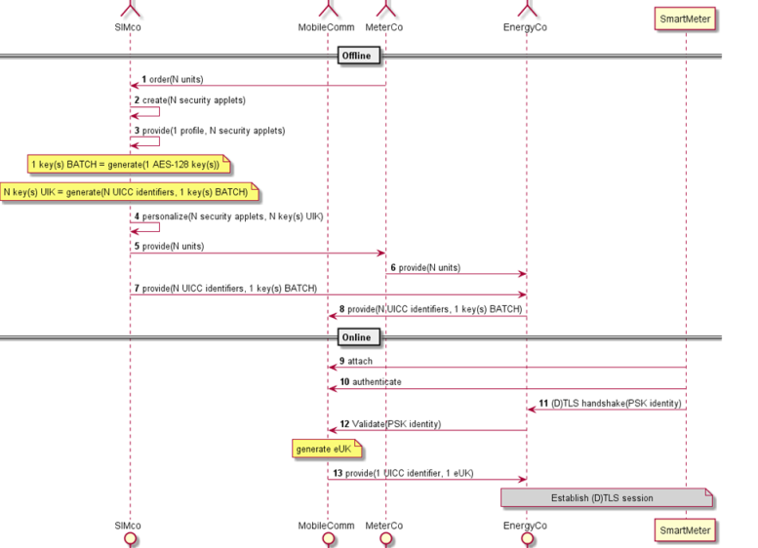
Scenario 5 (PSK#3: Trusted third party manages security, derived on a per-batch basis, on behalf of application owner)

Slide 14
Applet Services to Run a (D)TLS1.2 Handshake
Get a random.
Put a public key in the applet store (issuer certificate deployment model).
Verify a signature.
Generate a signature.
Generate an ECC key pair.
Compute the Diffie-Hellman shared secret (pre-master secret).
(optional) Compute the master secret with the PRF function.

Slide 15
Applet Services to Run a (D)TLS1.3 Handshake
(Optional) Compute the early secret with the HKDF function
Get a random.
Put a public key in the applet store (issuer certificate deployment model).
Verify a signature.
Generate a signature.
Generate an ECC key pair.
Compute the Diffie-Hellman shared secret.
(optional) Compute the handshake secret with the HKDF function.
(optional) Compute the master secret with the HKDF function.

Slide 16
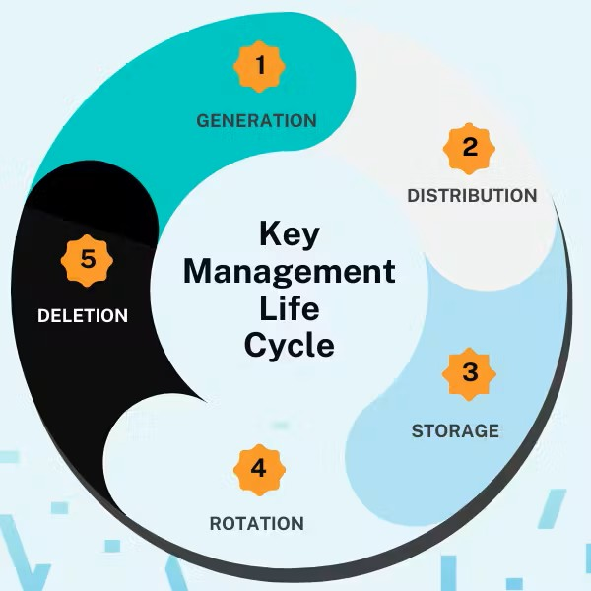
Key Lifecycle Management

Slide 17
Key Lifecycle Management
Key Generation: Key generation is the initial step in securing IoT communications, creating cryptographic keys within a secure environment to protect against unauthorized access. In IoT SAFE, asymmetric keys, often using elliptic curve cryptography (ECC) like ECDSA and ECDH, are generated for secure public/private key pairs. Symmetric keys, such as AES, are also created using hardware-based true random number generators (TRNGs) to ensure unpredictability. These keys are generated within the secure environment of the IoT SAFE-enabled SIM, protecting them from exposure to potentially insecure host environments. Standards like FIPS 140-2 Level 3+, ISO/IEC 19790, and Common Criteria (CC) ensure that the key generation process meets high security requirements.
Key Distribution: Once keys are generated, they need to be securely distributed to IoT devices and cloud platforms. IoT SAFE uses secure protocols like Remote Application Management (RAM) and GlobalPlatform Secure Channel Protocol (SCP) for OTA key distribution over mobile networks. This process includes the secure transmission of both symmetric and asymmetric keys, where symmetric keys are often wrapped for security using algorithms like AES-KW, and public keys may be encrypted with the recipient’s public key. Efficient distribution protocols are critical for scalability and minimizing security risks, especially when managing keys for millions of IoT devices.

Slide 18
Key Lifecycle Management
Key Storage: Key storage involves securing cryptographic keys to prevent unauthorized access or tampering. In IoT SAFE, keys are stored within the tamper-resistant memory of the SIM, ensuring they remain protected from external threats. The SIM uses strict access control policies, allowing only authorized applications to access specific keys, and ensures that keys are encrypted when stored. This secure storage complies with global standards like GlobalPlatform Card Specifications and ETSI TS 102 223, ensuring that the keys remain safe even in the event of physical tampering with the device.
Key Rotation: Key rotation ensures that cryptographic keys are periodically replaced to mitigate the risk of key compromise. IoT SAFE supports automated key rotation, either on a schedule (e.g., every 90 days) or after a certain number of uses. These new keys are distributed securely to devices and synchronized with cloud platforms to maintain consistency. Policy-driven key rotation helps enforce security best practices, minimizing the exposure of keys over time and ensuring compliance with regulations like PCI DSS or NIST SP 800-57.

Slide 19
Compare to Non IoT SAFE
IoT SAFE enhances security through the integration of hardware-based trusted execution environments (TEEs) and secure elements (SEs), which safeguard cryptographic keys and sensitive data from physical and software-based attacks. This hardware-centric approach provides robust defense against side-channel, tampering, and malware attacks, ensuring data integrity and confidentiality. In contrast, non-IoT SAFE systems typically rely on software-based security mechanisms, making them more prone to vulnerabilities such as privilege escalation and software exploits. Although IoT SAFE introduces additional latency due to hardware interactions, this trade-off is warranted in high-security applications, offering superior resilience to sophisticated threats. Non-IoT SAFE systems, while more performant, are less scalable in terms of security and require ongoing patching to mitigate emerging threats.

Slide 20
Conclusion
IoT SAFE simplifies IoT security by leveraging SIM technology to ensure scalable and robust protection. Compared to non-IoT SAFE methods, it offers streamlined key management and secure communication, addressing critical IoT challenges. Adopting IoT SAFE is crucial for organizations seeking efficient, standardized, and secure IoT deployments.

